Slide 1
Ciência de Dados Quântica 22/23 Classical Machine Learning: Neural Networks
Luís Paulo santos

Slide 2


Material de Consulta
Maria Schuld, Francesco Petruccione “Machine Learning with Quantum Computers” Cap. 2
Luís G. Serrano “grokking Machine Learning” Cap. 10 e apêndice B

Slide 3
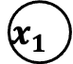


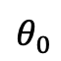


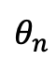

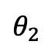
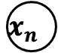
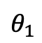
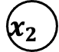

Perceptrons
Perceptron Classifier: $f_{activation}\left(\right)=step\left(\right)$
$$x_{1}$$
$$θ_{1}$$
$$x_{2}$$
$$θ_{2}$$
$$\hat{y}(x)=f_{activation}\left(θ_{0}+\sum_{i=1}^{n}{θ_{i}x_{i}}\right)$$
$$⋮$$
$$f$$
$$x_{n}$$
$$θ_{n}$$
$$θ_{0}$$
$$1$$
Logistic Classifier:
$$f_{activation}\left(\right)=σ\left(\right)$$
Input
Output

Slide 4
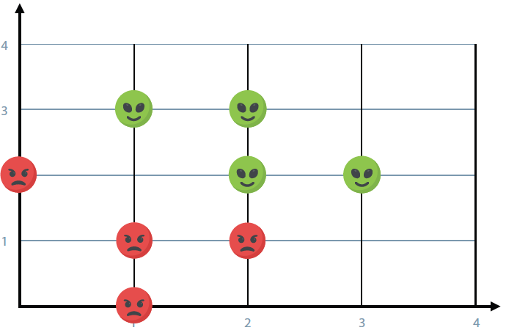
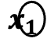


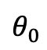

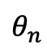

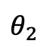
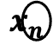
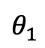
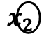
Neural Networks
$$x_{1}$$
$$θ_{1}$$
$$x_{2}$$
$$θ_{2}$$
$$⋮$$
$$f$$
$$x_{n}$$
$$θ_{n}$$
$$θ_{0}$$
$$1$$
$$\hat{y}(x)=σ\left(θ_{0}+\sum_{i=1}^{n}{θ_{i}x_{i}}\right)$$

Slide 5
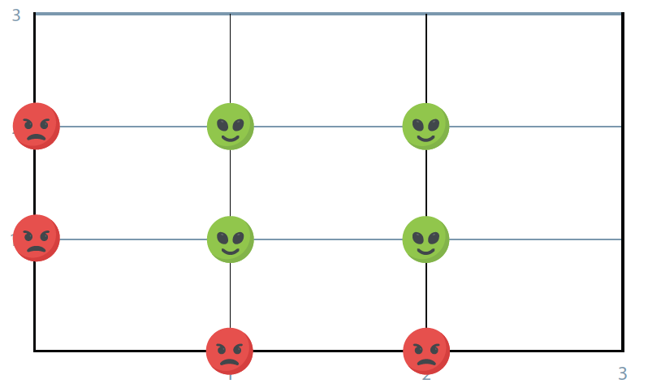



Neural Networks
$$h_{1}(x)=σ\left(θ_{1,0}+\sum_{i=1}^{n}{θ_{1,i}x_{i}}\right)$$
$$h_{2}(x)=σ\left(θ_{2,0}+\sum_{i=1}^{n}{θ_{2,i}x_{i}}\right)$$
$$\hat{y}(x)=σ\left(φ_{0}+\sum_{i=1}^{H}{φ_{i}h_{i}\left(x\right)}\right)$$

Slide 6
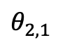
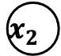
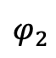

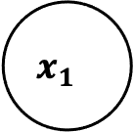
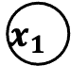

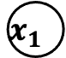
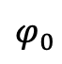



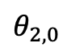

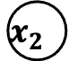
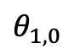

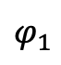


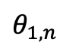
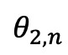

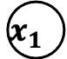
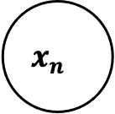

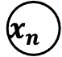

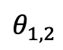
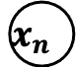
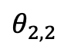


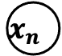
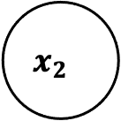
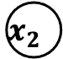
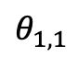
Neural Networks
$$x_{1}$$
$$θ_{1,1}$$
$$θ_{1,2}$$
$$x_{1}$$
$$x_{2}$$
$$⋮$$
$$h_{1}$$
$$x_{n}$$
$$θ_{1,n}$$
$$x_{2}$$
$$φ_{1}$$
$$h_{1}$$
$$x_{1}$$
$$θ_{1,0}$$
$$1$$
$$x_{2}$$
$$f$$
$$h_{1}$$
$$⋮$$
$$f$$
$$f$$
$$⋮$$
$$x_{1}$$
$$h_{2}$$
$$h_{2}$$
$$θ_{2,1}$$
$$φ_{2}$$
$$x_{n}$$
$$x_{2}$$
$$θ_{2,2}$$
$$φ_{0}$$
$$x_{n}$$
$$⋮$$
$$h_{2}$$
$$1$$
$$x_{n}$$
$$θ_{2,n}$$
$$θ_{2,0}$$
$$1$$
Input
Layer
Hidden
Layer(s)
Output
Layer

Slide 7
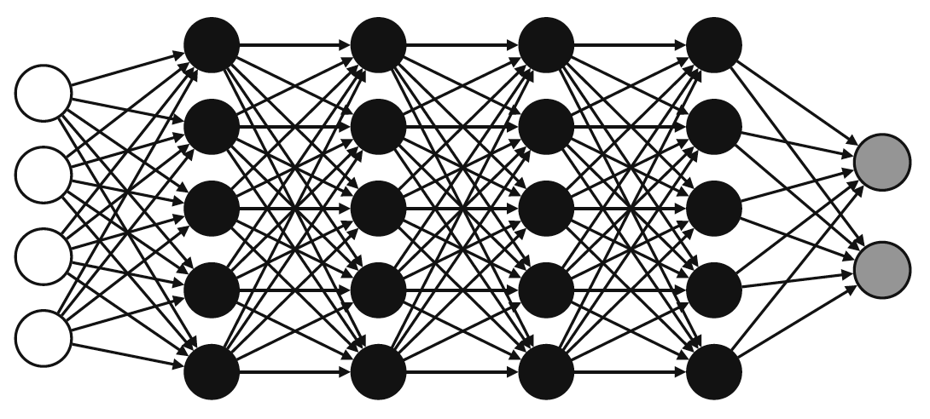
Fully connected feed forward NN
Input
Layer
Hidden
Layer(s)
Output
Layer

Slide 8
Neural Networks boundaries

Slide 9
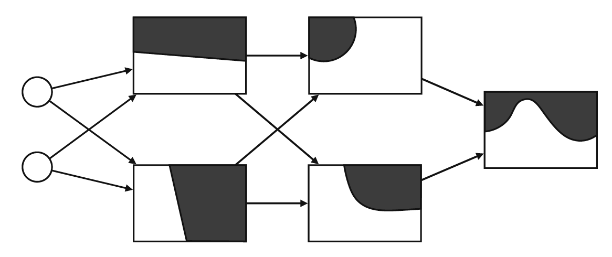
Neural Networks boundaries

Slide 10
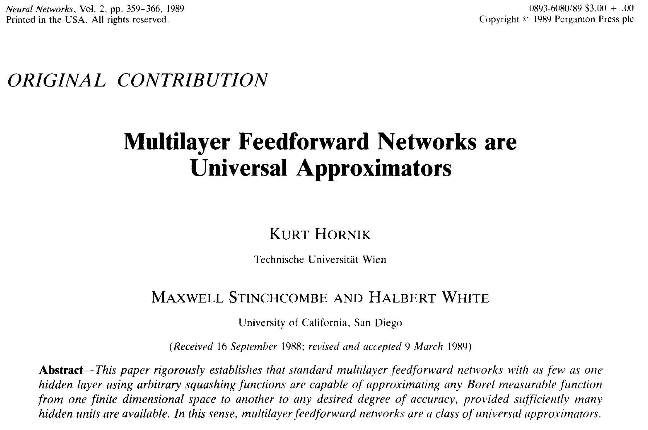
Universal Approximation Theorem
“…multilayer feed-forward networks with as few as one hidden layer are universal approximators.”
[https://en.wikipedia.org/wiki/Universal_approximation_theorem]

Slide 11


Error Function: log loss
$$LL\left(y,\hat{y}\right)=−y ln\left(\hat{y}\right)−\left(1−y\right)ln\left(1−\hat{y}\right)=\left\{\begin{matrix}0 & ←y=\hat{y} \\ \begin{matrix}−ln\left(\hat{y}\right) \\ −ln\left(1−\hat{y}\right)\end{matrix} & \begin{matrix}←\hat{y}≠y∧y=1 \\ ←\hat{y}≠y∧y=0\end{matrix}\end{matrix}\right.$$
Review: why the log loss?
logarithms suit probabilities well: the logarithm of a product is the sum of the individual factors logarithms
the logarithm has an analytical simple derivative
the value of the log loss grows with the difference $y−\hat{y}$
The log loss is related to cross entropy from information theory

Slide 12
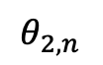

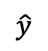
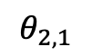
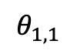
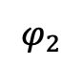
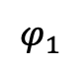
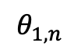

Gradient Descent
$$∇_{Θ}=\left(\begin{matrix}\begin{matrix}\begin{matrix}\frac{∂}{∂φ_{0}} \\ ⋮\end{matrix} \\ \begin{matrix}\frac{∂}{∂φ_{H}} \\ \frac{∂}{∂θ_{1,0}} \\ ⋮\end{matrix}\end{matrix} \\ \begin{matrix}\begin{matrix}\frac{∂}{∂θ_{1,n}} \\ ⋮\end{matrix} \\ \begin{matrix}\frac{∂}{∂θ_{H,0}} \\ ⋮ \\ \frac{∂}{∂θ_{H,n}}\end{matrix}\end{matrix}\end{matrix}\right)$$
$$x_{1}$$
$$θ_{1,1}$$
$$θ_{2,1}$$
$$x_{2}$$
$$h_{1}$$
$$φ_{1}$$
$$\hat{y}$$
$$Θ^{\left(t+1\right)}=Θ^{\left(t\right)}−η∇_{Θ}LL\left(\hat{y}\left(x\right),y\right)$$
$$f$$
$$⋮$$
$$θ_{1,n}$$
$$h_{2}$$
$$φ_{2}$$
$$x_{n}$$
$$θ_{2,n}$$

Slide 13






Gradient Descent: back propagation
$$\hat{y}=σ\left(φ_{0}+\sum_{j=1}^{H}{φ_{j}h_{j}}\right)$$
$$x_{1}$$
$$θ_{1,1}$$
$$s=φ_{0}+\sum_{j=1}^{H}{φ_{j}h_{j}}$$
$$θ_{2,1}$$
$$\hat{y}=σ\left(s\right)$$
$$x_{2}$$
$$h_{1}$$
$$φ_{1}$$
$$\hat{y}$$
$$f$$
$$⋮$$
$$θ_{1,n}$$
$$h_{j}=σ\left(θ_{j,0}+\sum_{i=1}^{n}{θ_{j,i}x_{i}}\right)$$
$$h_{2}$$
$$φ_{2}$$
$$x_{n}$$
$$θ_{2,n}$$
$$r_{j}=θ_{j,0}+\sum_{i=1}^{n}{θ_{j,i}x_{i}}$$
$$h_{j}=σ\left(r_{j}\right)$$

Slide 14




Gradient Descent: back propagation
$$LL\left(y,\hat{y}\right)=−y ln\left(\hat{y}\right)−\left(1−y\right)ln\left(1−\hat{y}\right)$$
$$x_{1}$$
$$θ_{1,1}$$
$$θ_{2,1}$$
$$\frac{∂ln\left(u\right)}{∂u}=\frac{1}{u}$$
$$x_{2}$$
$$h_{1}$$
$$φ_{1}$$
$$\hat{y}$$
$$f$$
$$⋮$$
$$θ_{1,n}$$
$$h_{2}$$
$$φ_{2}$$
$$\frac{∂σ\left(u\right)}{∂u}=σ\left(u\right)\left(1−σ\left(u\right)\right)$$
$$x_{n}$$
$$θ_{2,n}$$
$$\frac{∂u}{∂v}=\frac{∂t}{∂v}\frac{∂u}{∂t}$$

Slide 15






Gradient Descent: back propagation
Remember:
$$\frac{∂LL}{∂\hat{y}}=−\frac{y}{\hat{y}}−\frac{−\left(1−y\right)}{\left(1−\hat{y}\right)}=\frac{−\left(y−\hat{y}\right)}{\hat{y}\left(1−\hat{y}\right)}$$
$$LL\left(y,\hat{y}\right)=−y ln\left(\hat{y}\right)−\left(1−y\right)ln\left(1−\hat{y}\right)$$
$$s=φ_{0}+\sum_{j=1}^{H}{φ_{j}h_{j}}$$
$$\frac{∂\hat{y}}{∂s}=σ\left(s\right)\left(1−σ\left(s\right)\right)=\hat{y}\left(1−\hat{y}\right)$$
$$\hat{y}=σ\left(s\right)$$
$$\frac{∂LL}{∂s}=\frac{∂LL}{∂\hat{y}}\frac{∂\hat{y}}{∂s}=\frac{−\left(y−\hat{y}\right)}{\hat{y}\left(1−\hat{y}\right)}\hat{y}\left(1−\hat{y}\right)=−\left(y−\hat{y}\right)$$

Slide 16










Gradient Descent: back propagation
Remember:
$$\frac{∂s}{∂φ_{j>0}}=h_{j}$$
$$\frac{∂s}{∂φ_{0}}=1$$
$$s=φ_{0}+\sum_{j=1}^{H}{φ_{j}h_{j}}$$
$$\frac{∂s}{∂h_{j}}=φ_{j}$$
$$\frac{∂h_{j}}{∂r_{j}}=σ\left(r_{j}\right)\left(1−σ\left(r_{j}\right)\right)=h_{j}\left(1−h_{j}\right)$$
$$h_{j}=σ\left(θ_{j,0}+\sum_{i=1}^{n}{θ_{j,i}x_{i}}\right)$$
$$\frac{∂r_{j}}{∂θ_{j,i>0}}=x_{i}$$
$$\frac{∂r_{j}}{∂{θj,}_{0}}=1$$
$$r_{j}=θ_{j,0}+\sum_{i=1}^{n}{θ_{j,i}x_{i}}$$
$$h_{j}=σ\left(r_{j}\right)$$

Slide 17





Gradient Descent: back propagation
By applying the previous results:
$$\frac{∂LL}{∂s}=−\left(y−\hat{y}\right)$$
$$\frac{∂LL}{∂φ_{j>0}}=\frac{∂s}{∂φ_{j>0}}\frac{∂LL}{∂s}=−\left(y−\hat{y}\right)h_{j}$$
$$\frac{∂LL}{∂φ_{0}}=\frac{∂s}{∂φ_{0}}\frac{∂LL}{∂s}=−\left(y−\hat{y}\right)$$
$$\frac{∂LL}{∂θ_{j,i>0}}=\frac{∂r_{j}}{∂θ_{j,i>0}}\frac{∂h_{j}}{∂r_{j}}\frac{∂s}{∂h_{j}}\frac{∂LL}{∂s}=−\left(y−\hat{y}\right)φ_{j}h_{j}\left(1−h_{j}\right)x_{i}$$
$$\frac{∂LL}{∂θ_{j,0}}=\frac{∂r_{j}}{∂θ_{j,0}}\frac{∂h_{j}}{∂r_{j}}\frac{∂s}{∂h_{j}}\frac{∂LL}{∂s}=−\left(y−\hat{y}\right)φ_{j}h_{j}\left(1−h_{j}\right)$$

Slide 18

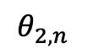









Gradient Descent: back propagation
$$Θ^{\left(t+1\right)}=Θ^{\left(t\right)}−η∇_{Θ}LL\left(\hat{y}\left(x\right),y\right)$$
$$x_{1}$$
$$θ_{1,1}$$
$$θ_{2,1}$$
$$φ_{j>0}^{(t+1)}=φ_{j>0}^{(t)}−η\left[−\left(y−\hat{y}\right)h_{j}\right]$$
$$x_{2}$$
$$h_{1}$$
$$φ_{1}$$
$$\hat{y}$$
$$φ_{0}^{(t+1)}=φ_{0}^{(t)}−η\left[−\left(y−\hat{y}\right)\right]$$
$$f$$
$$⋮$$
$$θ_{1,n}$$
$$h_{2}$$
$$φ_{2}$$
$$θ_{j,i>0}^{(t+1)}=θ_{j,i>0}^{(t)}−η\left[−\left(y−\hat{y}\right)φ_{j}h_{j}\left(1−h_{j}\right)x_{i}\right]$$
$$x_{n}$$
$$θ_{2,n}$$
$$θ_{j, 0}^{(t+1)}=θ_{j, 0}^{(t)}−η\left[−\left(y−\hat{y}\right)φ_{j}h_{j}\left(1−h_{j}\right)\right]$$

Slide 19


Neural Networks: overfitting
Regularization
$$C_{Θ}\left(x,y\right)=LL\left(\hat{y}\left(x\right),y\right)+λ∗{\left\|Θ\right\|}_{ℓ}$$
Dropout
at each epoch randomly select some of the nodes not to be trained

Slide 20


Neural Networks: vanishing gradients
flat regions ($∇_{Θ}≈0$) hinder
gradient descent from progressing to the global minimum

Slide 21





Neural Networks: vanishing gradients
$Θ^{\left(0\right)}$ initialization strategy
use activation functions with non-zero derivatives
$$\frac{∂}{∂x}$$
[https://www.engati.com/glossary/vanishing-gradient-problem]

Slide 22






Multi label NN
$${\hat{y}}_{1}\left(x\right)$$
Softmax
$$p\left(y\left(x\right)=l_{1}\right)$$
$$⋮$$
$${\hat{y}}_{L}\left(x\right)$$
$$p\left(y\left(x\right)=l_{L}\right)$$
$$p\left(y\left(x\right)=l_{l}\right)=\frac{e^{{\hat{y}}_{L}\left(x\right)}}{\sum_{j=1}^{L}{e^{{\hat{y}}_{j}\left(x\right)}}}$$

Slide 23


Convolution Neural Networks
[TowardsDataScience.com]

Slide 24


Generative Adversarial Networks
[Medium.com]

Slide 25

Recurrent Neural Networks
RNNs perform the same task for every element of a sequence, with the output being dependent on the previous computations
RNNs behave as if they had a “memory” which captures information about what has been calculated so far.
[Medium.com]

